Slide 1



Software Engineering Project
AI DESKTOP ASSISTANT
Aarav Maan 21BCT0016 ~ ARMNX

Slide 2

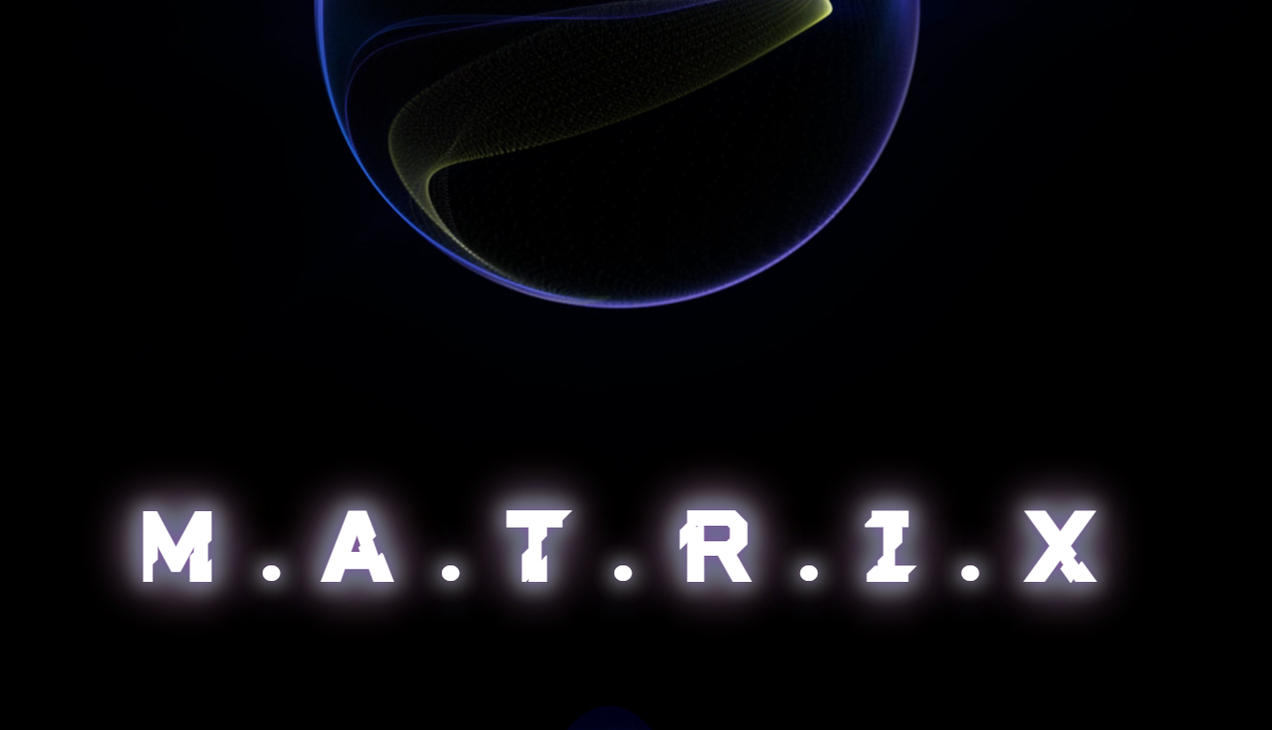

INTRODUCTION
Imagine a virtual assistant that not only understands your requests but also responds in a natural, engaging way. That's the power of generative AI, and today, we'll be exploring its potential with Matrix, a virtual assistant we've developed. We'll delve into how generative AI works, how it empowers Matrix, and the exciting possibilities it holds for the future of virtual assistants. Let's dive in!

Slide 3

Generative AI refers to a class of artificial intelligence models that can create new and original data, such as text, images, code, or even music.
These models are trained on massive datasets of existing data, allowing them to learn the underlying patterns and relationships.
By leveraging this knowledge, generative AI models can generate entirely new data pieces that resemble the training data but haven't been directly seen before.
Understanding
GEN AI

Slide 4
Generative Adversarial Networks (GANs): Two neural networks compete against each other. One (generator) creates new data, while the other (discriminator) tries to distinguish real data from the generated data. This competition refines the generator's ability to produce realistic outputs.
Variational Autoencoders (VAEs): Encode input data into a compressed latent space, then decode it to reconstruct the original data or generate similar variations. VAEs are often used for data compression and anomaly detection.
Understanding
GEN AI

Slide 5

Benefits
GEN AI ~ VA’S
Enhanced Accuracy:
Generative AI models can handle complex queries by understanding the context and relationships between words.
They can process factual, open-ended, and task-oriented requests with greater accuracy compared to traditional rule-based systems.
Enhanced Accuracy: Generative AI models can handle complex queries by understanding the context and relationships between words. They can process factual, open-ended, and task-oriented requests with greater accuracy compared to traditional rule-based systems.
Increased User Satisfaction:
By providing accurate and natural interactions, generative AI virtual assistants like Matrix lead to higher user satisfaction.
Users feel they are understood and receive helpful, informative responses, leading to a more positive experience.

Slide 6
Matrix System Architecture - Working Together for Intelligent Assistance
Enhanced Accuracy in Handling Complex Queries :
By delving deeper into the context and relationships between words, Matrix's generative AI model tackles even intricate queries with greater precision, ensuring a reliable and accurate response.
OBJECTIVES
Improved Fluency and Natural Language Generation :
Matrix, our virtual assistant, leverages the power of generative AI to revolutionize user interactions. This translates to a more natural and engaging experience. Unlike traditional assistants, Matrix can handle complex queries with improved accuracy, understanding the context and relationships between words. Additionally, responses are no longer robotic and repetitive. Generative AI allows Matrix to generate natural language that flows smoothly and is grammatically correct. This results in a more positive user experience with a sense of being truly understood and receiving helpful, informative responses.
Generative AI empowers Matrix to move beyond robotic pronouncements. Instead, it crafts natural language responses that flow seamlessly and adhere to grammatical rules, mimicking human conversation for a more engaging experience.
Increased User Satisfaction Through Helpful Interactions:
The combination of enhanced accuracy and natural language generation fosters a positive user experience. Users appreciate Matrix's ability to understand their needs and provide helpful, informative responses, leading to a sense of satisfaction and trust in Matrix's capabilities.

Slide 7
Understanding User Intent
The Power of NLP
01
Intent Recognition
02
Entity Extraction
This involves identifying the underlying goal or purpose behind the user's query. Is the user asking a question, requesting a task, or seeking information? Accurately identifying intent is crucial for providing relevant responses.
NLP pinpoints and classifies specific entities mentioned in the query, such as names, locations, dates, or objects. This extracted information helps Matrix understand the context and specifics of the user's request.
03
Sentiment Analysis
Beyond just the literal meaning, NLP can also analyze the emotional tone of the user's query (positive, negative, neutral). This allows Matrix to tailor its responses accordingly, fostering a more natural and empathetic interaction.

Slide 8




CORE OF MATRIX: THE GEMINI API
Harnessing Gemini's Potential: Matrix utilizes the Gemini API, a state-of-the-art generative AI API developed by Google AI. This API provides access to advanced models trained on massive datasets,
Customizing for Matrix:
We can leverage the flexibility of the Gemini API to tailor the model to Matrix's specific needs and functionalities. This allows for fine-tuning based on the desired domain or application, further enhancing the accuracy and relevance of responses.
Beyond Textual Responses: Depending on the chosen Gemini model variation, Matrix can go beyond pure text generation. The API might enable functionalities like generating images, translating languages, or writing different creative text formats, expanding Matrix's potential for richer interactions.

Slide 9
FUTURE ENHANCEMENTS - EXPANDING MATRIX'S CAPABILITIES
CONTEXT-AWARE RESPONSES
PERSONALIZED RECOMMENDATIONS
INTEGRATION WITH ADDITIONAL AI MODELS
Taking user history and past interactions into account, Matrix can personalize responses and recommendations, creating a more natural and engaging user experience.
Based on user preferences and past behavior, Matrix can proactively suggest actions, tasks, or information relevant to the user's needs, adding an extra layer of helpfulness.
Matrix can be further enhanced by integrating with other AI models, such as computer vision or sentiment analysis tools. This allows for a more comprehensive understanding of user intent and surroundings, leading to richer and more contextual interactions.

Slide 10



Future Enhancements
OPTIMIZING PERFORMANCE
Fine-tuning on Domain Data (35 words): The current generative AI model might be trained on a broad dataset. To further enhance performance in specific areas, we can fine-tune the model using domain-specific datasets. For example, if Matrix is used in healthcare, training on a medical text corpus can improve its understanding of medical terminology and provide more accurate responses.
Experimenting with Architectures and Techniques (35 words): The field of generative AI is constantly evolving. By experimenting with different model architectures and training techniques, we can explore ways to improve the quality, accuracy, and creativity of Matrix's generated responses.

Slide 11

Impact and Applications
Customer Service: Imagine virtual assistants in customer service centers handling complex inquiries with ease, understanding nuances and resolving issues efficiently.
Education: Personalized learning experiences can be tailored by AI tutors, catering to individual student needs and providing interactive, engaging explanations.
Healthcare: Generative AI assistants can support patients by scheduling appointments, answering medical questions in a clear and informative way, and potentially aiding with early symptom detection through analysis of user queries.

Slide 12

CONCLUSION
A FUTURE OF INTELLIGENT AND ENGAGING INTERACTIONS
We've explored the exciting potential of Matrix, a virtual assistant powered by generative AI. Here's a quick recap:
Generative AI Revolutionizes Virtual Assistants: This technology empowers Matrix to understand complex queries, generate natural language responses, and provide a more user-friendly experience.
Benefits for Users: Enhanced accuracy, improved fluency, and increased user satisfaction are key advantages of generative AI virtual assistants.
Matrix: A Powerful Tool: By leveraging the Gemini API and exploring future enhancements, Matrix can be continuously refined and expanded to offer even greater capabilities.
Looking Ahead:
The integration of generative AI holds immense promise for the future of human-computer interaction. Virtual assistants like Matrix will become ever more sophisticated, fostering a new era of intelligent and engaging interactions across various domains.

Slide 13

THANK YOU
aarav.maan2021@vitstudent.ac.in

